Slide 1
Module 17: Transactions

Slide 2
Outline
Transaction Concept
Transaction State
Concurrent Executions
Serializability
Recoverability
Implementation of Isolation
Transaction Definition in SQL
Testing for Serializability.

Slide 3
Transaction Concept
A transaction is a unit of program execution that accesses and possibly updates various data items.
E.g., transaction to transfer $50 from account A to account B:
1. read(A)
2. A := A – 50
3. write(A)
4. read(B)
5. B := B + 50
6. write(B)
Two main issues to deal with:
Failures of various kinds, such as hardware failures and system crashes
Concurrent execution of multiple transactions

Slide 4
Example of Fund Transfer
Transaction to transfer $50 from account A to account B:
1. read(A)
2. A := A – 50
3. write(A)
4. read(B)
5. B := B + 50
6. write(B)
Atomicity requirement
If the transaction fails after step 3 and before step 6, money will be “lost” leading to an inconsistent database state
Failure could be due to software or hardware
The system should ensure that updates of a partially executed transaction are not reflected in the database
Durability requirement — once the user has been notified that the transaction has completed (i.e., the transfer of the $50 has taken place), the updates to the database by the transaction must persist even if there are software or hardware failures.

Slide 5
Example of Fund Transfer (Cont.)
Consistency requirement in above example:
The sum of A and B is unchanged by the execution of the transaction
In general, consistency requirements include
Explicitly specified integrity constraints such as primary keys and foreign keys
Implicit integrity constraints
e.g., sum of balances of all accounts, minus sum of loan amounts must equal value of cash-in-hand
A transaction must see a consistent database.
During transaction execution the database may be temporarily inconsistent.
When the transaction completes successfully the database must be consistent
Erroneous transaction logic can lead to inconsistency

Slide 6
Example of Fund Transfer (Cont.)
Isolation requirement — if between steps 3 and 6, another transaction T2 is allowed to access the partially updated database, it will see an inconsistent database (the sum A + B will be less than it should be).
T1 T2
1. read(A)
2. A := A – 50
3. write(A) read(A), read(B), print(A+B)
4. read(B)
5. B := B + 50
6. write(B
Isolation can be ensured trivially by running transactions serially
That is, one after the other.
However, executing multiple transactions concurrently has significant benefits, as we will see later.

Slide 7
ACID Properties
A transaction is a unit of program execution that accesses and possibly updates various data items. To preserve the integrity of data the database system must ensure:
Atomicity. Either all operations of the transaction are properly reflected in the database or none are.
Consistency. Execution of a transaction in isolation preserves the consistency of the database.
Isolation. Although multiple transactions may execute concurrently, each transaction must be unaware of other concurrently executing transactions. Intermediate transaction results must be hidden from other concurrently executed transactions.
That is, for every pair of transactions T_{i} and T_{j}, it appears to T_{i} that either T_{j}, finished execution before T_{i} started, or T_{j} started execution after T_{i} finished.
Durability. After a transaction completes successfully, the changes it has made to the database persist, even if there are system failures.

Slide 8
Transaction State
Active – the initial state; the transaction stays in this state while it is executing
Partially committed – after the final statement has been executed.
Failed -- after the discovery that normal execution can no longer proceed.
Aborted – after the transaction has been rolled back and the database restored to its state prior to the start of the transaction. Two options after it has been aborted:
Restart the transaction
Can be done only if no internal logical error
Kill the transaction
Committed – after successful completion.

Slide 9
Transaction State (Cont.)

Slide 10
Concurrent Executions
Multiple transactions are allowed to run concurrently in the system. Advantages are:
Increased processor and disk utilization, leading to better transaction throughput
E.g., one transaction can be using the CPU while another is reading from or writing to the disk
Reduced average response time for transactions: short transactions need not wait behind long ones.
Concurrency control schemes – mechanisms to achieve isolation
That is, to control the interaction among the concurrent transactions in order to prevent them from destroying the consistency of the database

Slide 11
Schedules
Schedule – a sequences of instructions that specify the chronological order in which instructions of concurrent transactions are executed
A schedule for a set of transactions must consist of all instructions of those transactions
Must preserve the order in which the instructions appear in each individual transaction.
A transaction that successfully completes its execution will have a commit instructions as the last statement
By default transaction assumed to execute commit instruction as its last step
A transaction that fails to successfully complete its execution will have an abort instruction as the last statement

Slide 12
Schedule 1
Let T₁ transfer $50 from A to B, and T₂ transfer 10% of the balance from A to B.
A serial schedule in which T₁ is followed by T₂ :

Slide 13
Schedule 2
A serial schedule where T₂ is followed by T₁

Slide 14
Schedule 3
Let T₁ and T₂ be the transactions defined previously. The following schedule is not a serial schedule, but it is equivalent to Schedule 1
In Schedules 1, 2 and 3, the sum A + B is preserved.

Slide 15
Schedule 4
The following concurrent schedule does not preserve the value of (A + B ).

Slide 16
Serializability
Basic Assumption – Each transaction preserves database consistency.
Thus, serial execution of a set of transactions preserves database consistency.
A (possibly concurrent) schedule is serializable if it is equivalent to a serial schedule. Different forms of schedule equivalence give rise to the notions of:
1. Conflict serializability
2. View serializability
Notes:
What is Conflict Serializability?
A schedule is called conflict serializable if we can convert it into a serial schedule after swapping its non-conflicting operations.
Conflicting operations
Two operations are said to be in conflict, if they satisfy all the following three conditions:
1. Both the operations should belong to different transactions. 2. Both the operations are working on same data item. 3. At least one of the operation is a write operation.
Lets see some examples to understand this: Example 1: Operation W(X) of transaction T1 and operation R(X) of transaction T2 are conflicting operations, because they satisfy all the three conditions mentioned above. They belong to different transactions, they are working on same data item X, one of the operation in write operation.
Example 2: Similarly Operations W(X) of T1 and W(X) of T2 are conflicting operations.
Example 3: Operations W(X) of T1 and W(Y) of T2 are non-conflicting operations because both the write operations are not working on same data item so these operations don’t satisfy the second condition.
Example 4: Similarly R(X) of T1 and R(X) of T2 are non-conflicting operations because none of them is write operation.
Example 5: Similarly W(X) of T1 and R(X) of T1 are non-conflicting operations because both the operations belong to same transaction T1.
Conflict Equivalent Schedules
Two schedules are said to be conflict Equivalent if one schedule can be converted into other schedule after swapping non-conflicting operations.
Conflict Serializable check
Lets check whether a schedule is conflict serializable or not. If a schedule is conflict Equivalent to its serial schedule then it is called Conflict Serializable schedule. Lets take few examples of schedules.
What is View Serializability?
View Serializability is a process to find out that a given schedule is view serializable or not.
To check whether a given schedule is view serializable, we need to check whether the given schedule is View Equivalent to its serial schedule. Lets take an example to understand what it means.
Why we need View Serializability?
We know that a serial schedule never leaves the database in inconsistent state because there are no concurrent transactions execution. However a non-serial schedule can leave the database in inconsistent state because there are multiple transactions running concurrently. By checking that a given non-serial schedule is view serializable, we make sure that it is a consistent schedule.
You may be wondering instead of checking that a non-serial schedule is serializable or not, can’t we have serial schedule all the time? The answer is no, because concurrent execution of transactions fully utilize the system resources and are considerably faster compared to serial schedules.
View Equivalent
Lets learn how to check whether the two schedules are view equivalent.
Two schedules T1 and T2 are said to be view equivalent, if they satisfy all the following conditions:
1. Initial Read: Initial read of each data item in transactions must match in both schedules. For example, if transaction T1 reads a data item X before transaction T2 in schedule S1 then in schedule S2, T1 should read X before T2.
Read vs Initial Read: You may be confused by the term initial read. Here initial read means the first read operation on a data item, for example, a data item X can be read multiple times in a schedule but the first read operation on X is called the initial read. This will be more clear once we will get to the example in the next section of this same article.
2. Final Write: Final write operations on each data item must match in both the schedules. For example, a data item X is last written by Transaction T1 in schedule S1 then in S2, the last write operation on X should be performed by the transaction T1.
3. Update Read: If in schedule S1, the transaction T1 is reading a data item updated by T2 then in schedule S2, T1 should read the value after the write operation of T2 on same data item. For example, In schedule S1, T1 performs a read operation on X after the write operation on X by T2 then in S2, T1 should read the X after T2 performs write on X.
View Serializable
If a schedule is view equivalent to its serial schedule then the given schedule is said to be View Serializable. Lets take an example.

Slide 17
Simplified view of transactions
We ignore operations other than read and write instructions
We assume that transactions may perform arbitrary computations on data in local buffers in between reads and writes.
Our simplified schedules consist of only read and write instructions.

Slide 18
Conflicting Instructions
Instructions l_{i} and l_{j} of transactions T_{i} and T_{j} respectively, conflict if and only if there exists some item Q accessed by both l_{i} and l_{j}, and at least one of these instructions wrote Q.
1. l_{i} = read(Q), l_{j} = read(Q). l_{i} and l_{j} don’t conflict. 2. l_{i} = read(Q), l_{j} = write(Q). They conflict. 3. l_{i} = write(Q), l_{j} = read(Q). They conflict 4. l_{i} = write(Q), l_{j} = write(Q). They conflict
Intuitively, a conflict between l_{i} and l_{j} forces a (logical) temporal order between them.
If l_{i} and l_{j} are consecutive in a schedule and they do not conflict, their results would remain the same even if they had been interchanged in the schedule.

Slide 19
Conflict Serializability
If a schedule S can be transformed into a schedule S’ by a series of swaps of non-conflicting instructions, we say that S and S’ are conflict equivalent.
We say that a schedule S is conflict serializable if it is conflict equivalent to a serial schedule

Slide 20
Conflict Serializability (Cont.)
Schedule 3 can be transformed into Schedule 6, a serial schedule where T₂ follows T₁, by series of swaps of non-conflicting instructions. Therefore Schedule 3 is conflict serializable.
Schedule 3
Schedule 6

Slide 21
Conflict Serializability (Cont.)
Example of a schedule that is not conflict serializable:
We are unable to swap instructions in the above schedule to obtain either the serial schedule < T₃, T₄ >, or the serial schedule < T₄, T₃ >.

Slide 22
Testing for Serializability
Consider some schedule of a set of transactions T₁, T₂, ..., T_{n}
Precedence graph — a direct graph where the vertices are the transactions (names).
We draw an arc from T_{i} to T_{j} if the two transaction conflict, and T_{i} accessed the data item on which the conflict arose earlier.
We may label the arc by the item that was accessed.
Example of a precedence graph

Slide 23
Testing for Serializability
Create:
node for each transaction;
a directed edge T_{i} → T_{j}, if T_{j} reads the value of an item written by T_{i};
a directed edge T_{i} → T_{j}, if T_{j} writes a value into an item after it has been read by T_{i}.

Slide 24
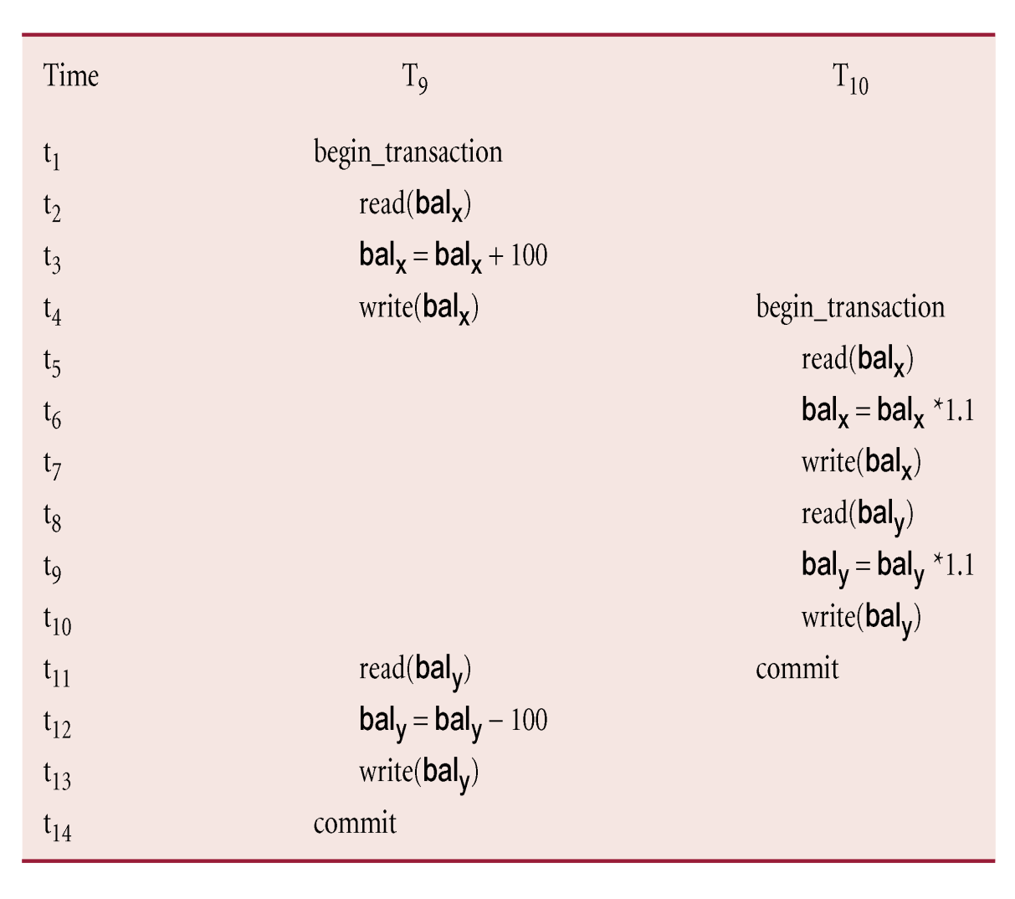
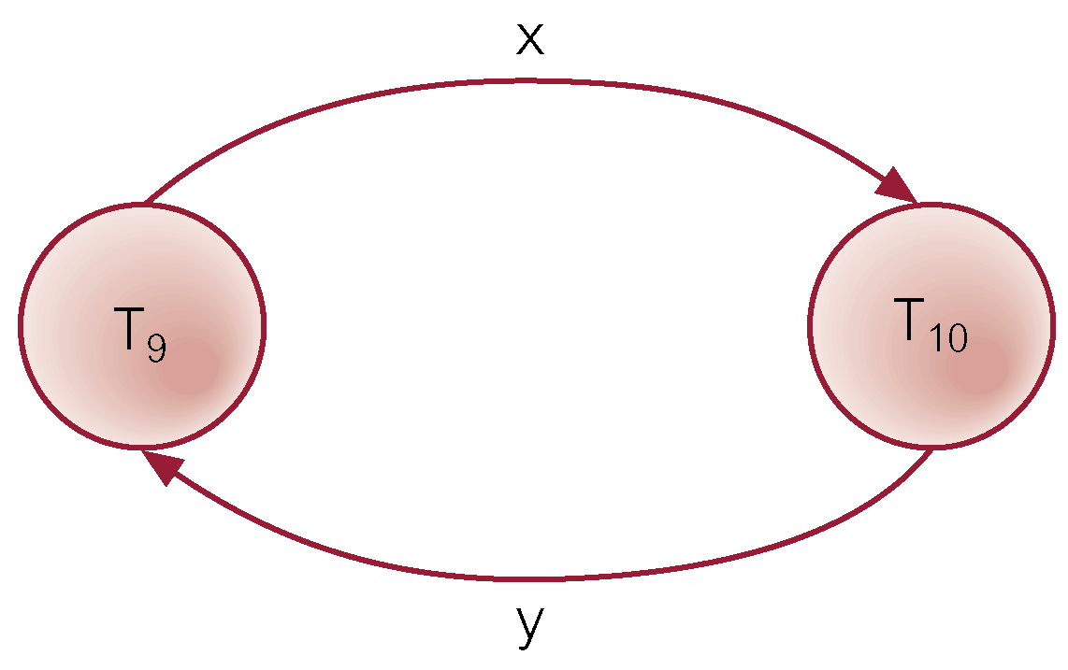
Example - Non-conflict serializable schedule

Slide 25
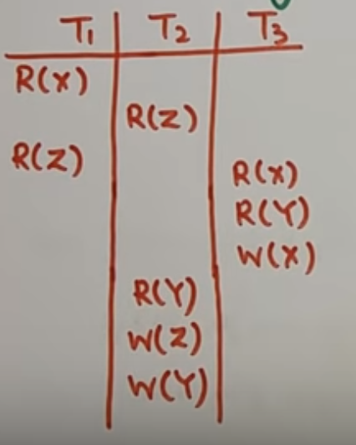
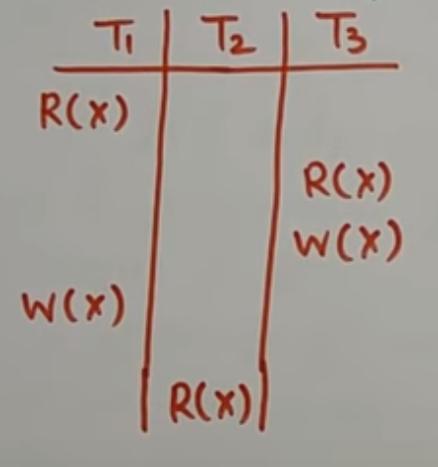
Check for conflict serializability

Slide 26
Recoverable Schedules
Need to address the effect of transaction failures on concurrently running transactions.
Recoverable schedule — if a transaction T_{j} reads a data item previously written by a transaction T_{i} , then the commit operation of T_{i} appears before the commit operation of T_{j}.
The following schedule (Schedule 11) is not recoverable
If T₈ should abort, T₉ would have read (and possibly shown to the user) an inconsistent database state. Hence, database must ensure that schedules are recoverable.

Slide 27
Cascading Rollbacks
Cascading rollback – a single transaction failure leads to a series of transaction rollbacks. Consider the following schedule where none of the transactions has yet committed (so the schedule is recoverable) If T₁₀ fails, T₁₁ and T₁₂ must also be rolled back.
Can lead to the undoing of a significant amount of work

Slide 28
Cascadeless Schedules
Cascadeless schedules — cascading rollbacks cannot occur;
For each pair of transactions T_{i} and T_{j} such that T_{j} reads a data item previously written by T_{i}, the commit operation of T_{i} appears before the read operation of T_{j}.
Every Cascadeless schedule is also recoverable
It is desirable to restrict the schedules to those that are cascadeless

Slide 29
Concurrency Control
A database must provide a mechanism that will ensure that all possible schedules are
either conflict or view serializable, and
are recoverable and preferably cascadeless
A policy in which only one transaction can execute at a time generates serial schedules, but provides a poor degree of concurrency
Are serial schedules recoverable/cascadeless?
Testing a schedule for serializability after it has executed is a little too late!
Goal – to develop concurrency control protocols that will assure serializability.

